Slide 1

I²C LED CONTROLLER USING PCA9685
Sinchan MS 4NM18EC085
Hansel Kevin Lewis 4NM18EC059
Hrithik Rahul 4NM18EC063
Pramod Mallapur 4NM19EC406
Ramesh Mallappa Kerur 4NM19EC408
Guide : Mr. Karthik
96114756
97615902

Slide 2
Introduction
Light Emitting Diodes (LEDs) are used in some of today’s most ubiquitous applications. LED controllers are necessary in most of these applications.
Example: Blinkers, back-lit keypads and LED screens, lighting status indicators, illumination control in LCD displays, TVs, mobile phones, ad boards and so on.
Challenges arises in controlling the various parameters of the LEDs, for example brightness, color and blinking time control.
Hence LED controller drivers come into the picture, which enables control of the above parameters.

Slide 3
PCA9685
PCA9685 is an I2C bus controlled , 16-channel, 12-bit controller.
works as an I2C slave device.
Each LED output has its own 12-bit resolution (4096 steps) fixed frequency individual PWM controller that operates at a programmable frequency from 24 Hz to 1526 Hz
PCA9685 operates with a supply voltage range of 2.3 V to 5.5 V
Fm+ devices offer higher frequency (up to 1 MHz)

Slide 4
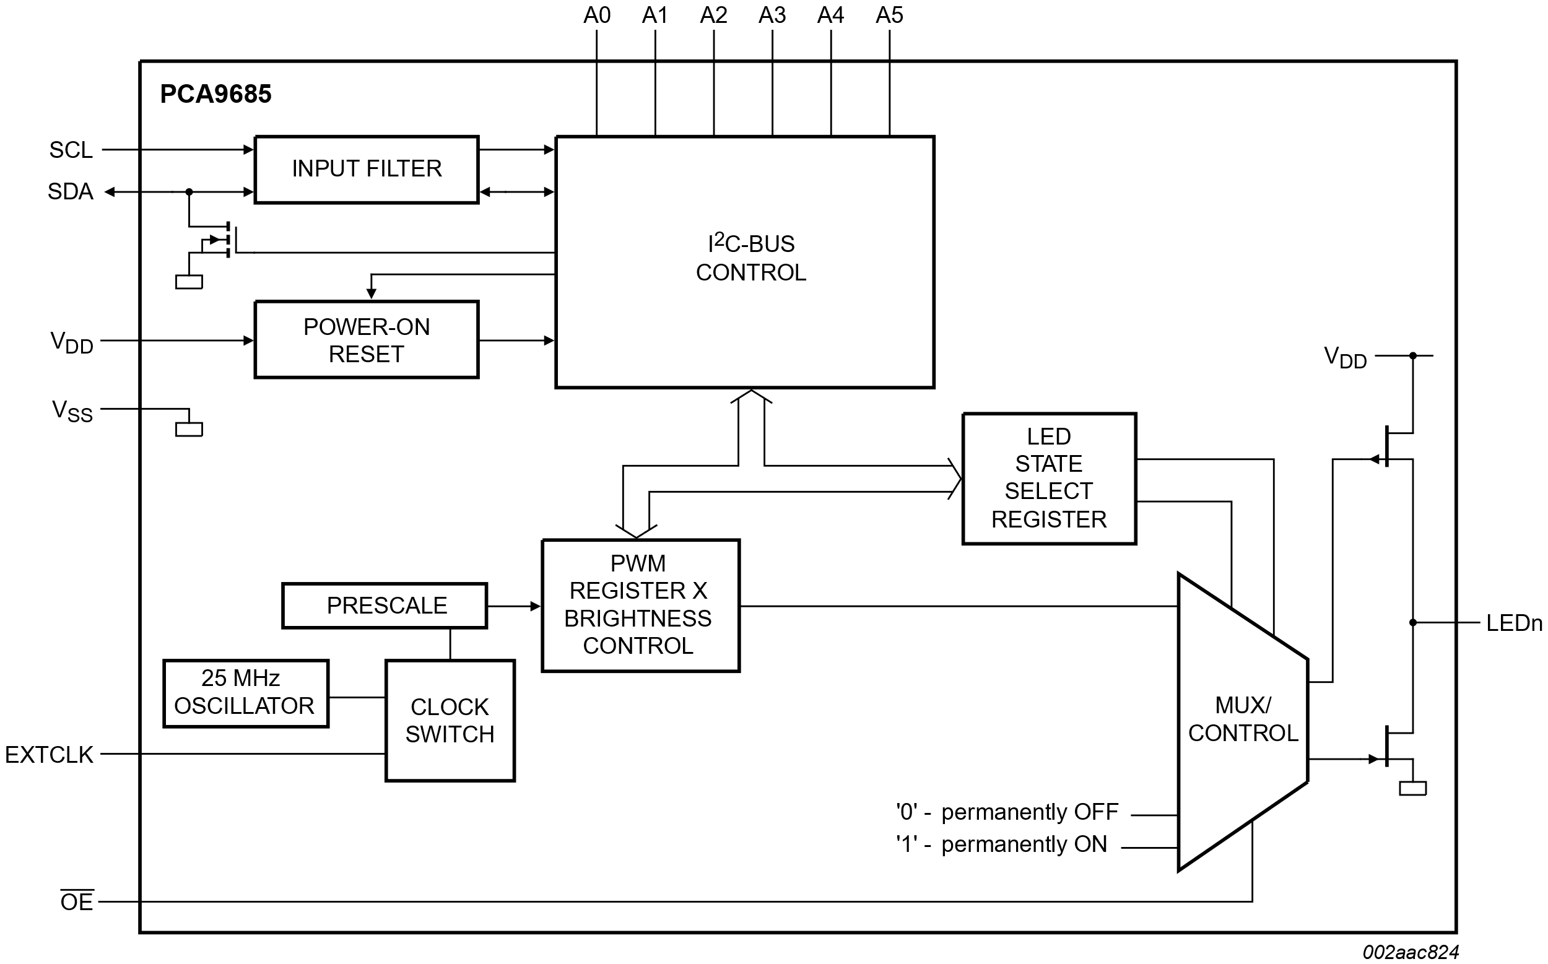
PCA9685 Block Diagram

Slide 5
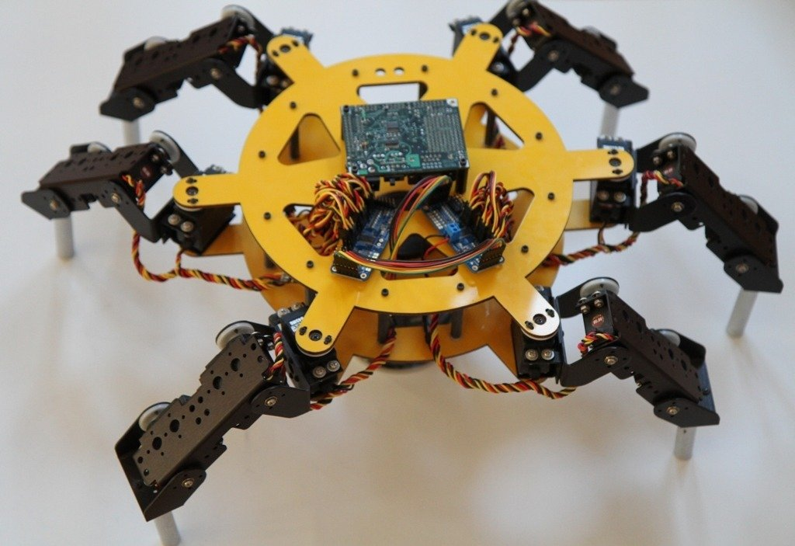
Application

Slide 6
I2C communication protocol
I2C stands for inter-integrated circuit communication protocol.
I2C Protocol is a way of serial communication between different devices to exchange their data with each other.
Uses Half-duplex bi-directional two-wire bus system for trans receiving data between masters (M) and slaves (S). These two wires are Serial clock line or SCL and Serial data line or SDA.
Notes:
The inter-integrated circuit or I2C Protocol is a way of serial communication between different devices to exchange their data with each other. It is a half-duplex bi-directional two-wire bus system for transmitting and receiving data between masters (M) and slaves (S). These two wires are Serial clock line or SCL and Serial data line or SDA.
The PCA9685 is an I²C-bus controlled 16-channel LED controller optimized for Red/Green/Blue/Amber (RGBA) color backlighting applications. Each LED output has its own 12-bit resolution (4096 steps) fixed frequency individual PWM controller that operates at a programmable frequency from a typical of 24 Hz to 1526 Hz with a duty cycle that is adjustable from 0 % to 100 % to allow the LED to be set to a specific brightness value. All outputs are set to the same PWM frequency.

Slide 7
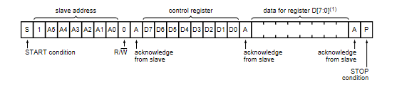
I2C communication protocol
I²C bus transactions
Write to a specific register
Write to all registers using the Auto-Increment feature
Read all registers using the Auto-Increment feature
Write to ALL_LED_ON and ALL_LED_OFF registers using the Auto-Increment feature
Write to ALL_LED_OFF_H to turn OFF all PWMs

Slide 8
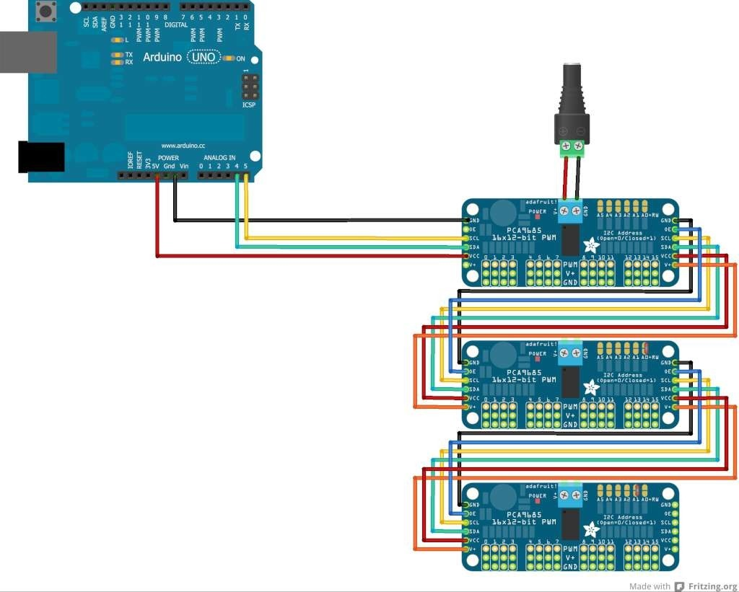
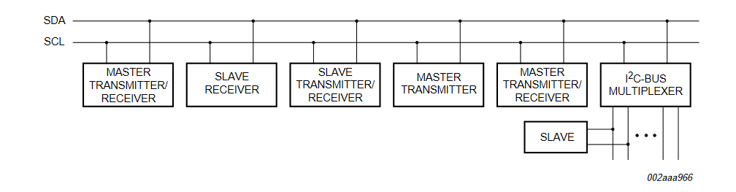
I²C Connection
PCA9685 will drive up to 16 servos over I2C with only 2 pins. Can chain up to 62 of them to control up to 992 servos - with the same 2 pins

Slide 9
Objectives
Utilize I2C protocol to manipulate or to control LEDs from ATMega 328 microcontroller.
Demonstrate control of various level of brightness, blinking time, color of the LEDs through the PCA9685 driver.
Demonstrate control of multiple RGB LEDs / LED matrix
Interfacing multiple PCA9685 drivers to single master
Notes:
These are the objectives of the project.

Slide 10
Block Diagram
SCL
Switching ON/OFF
I2C bus master
I2C Slave Device
16 Channel
12 Bit
LED Driver
5 RGB LEDs
device
SDA
Brightness
Control, color
ATMega328
PCA9685
Notes:
Block Diagram of the project. Here the I2C Master device used is an ATMega 328 Microcontroller, the I2C slave device used is the PCA9685 LED controller. The microcontroller uses the SDL to send instructions to the LED driver as to how the LEDs should be controlled. In essence, what should be the blinking time period, brightness variations, which LED should be turned ON or OFF, when to turn ON or OFF etc. The LED driver reads these instructions and controls the LEDs in the same manner.

Slide 11
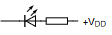
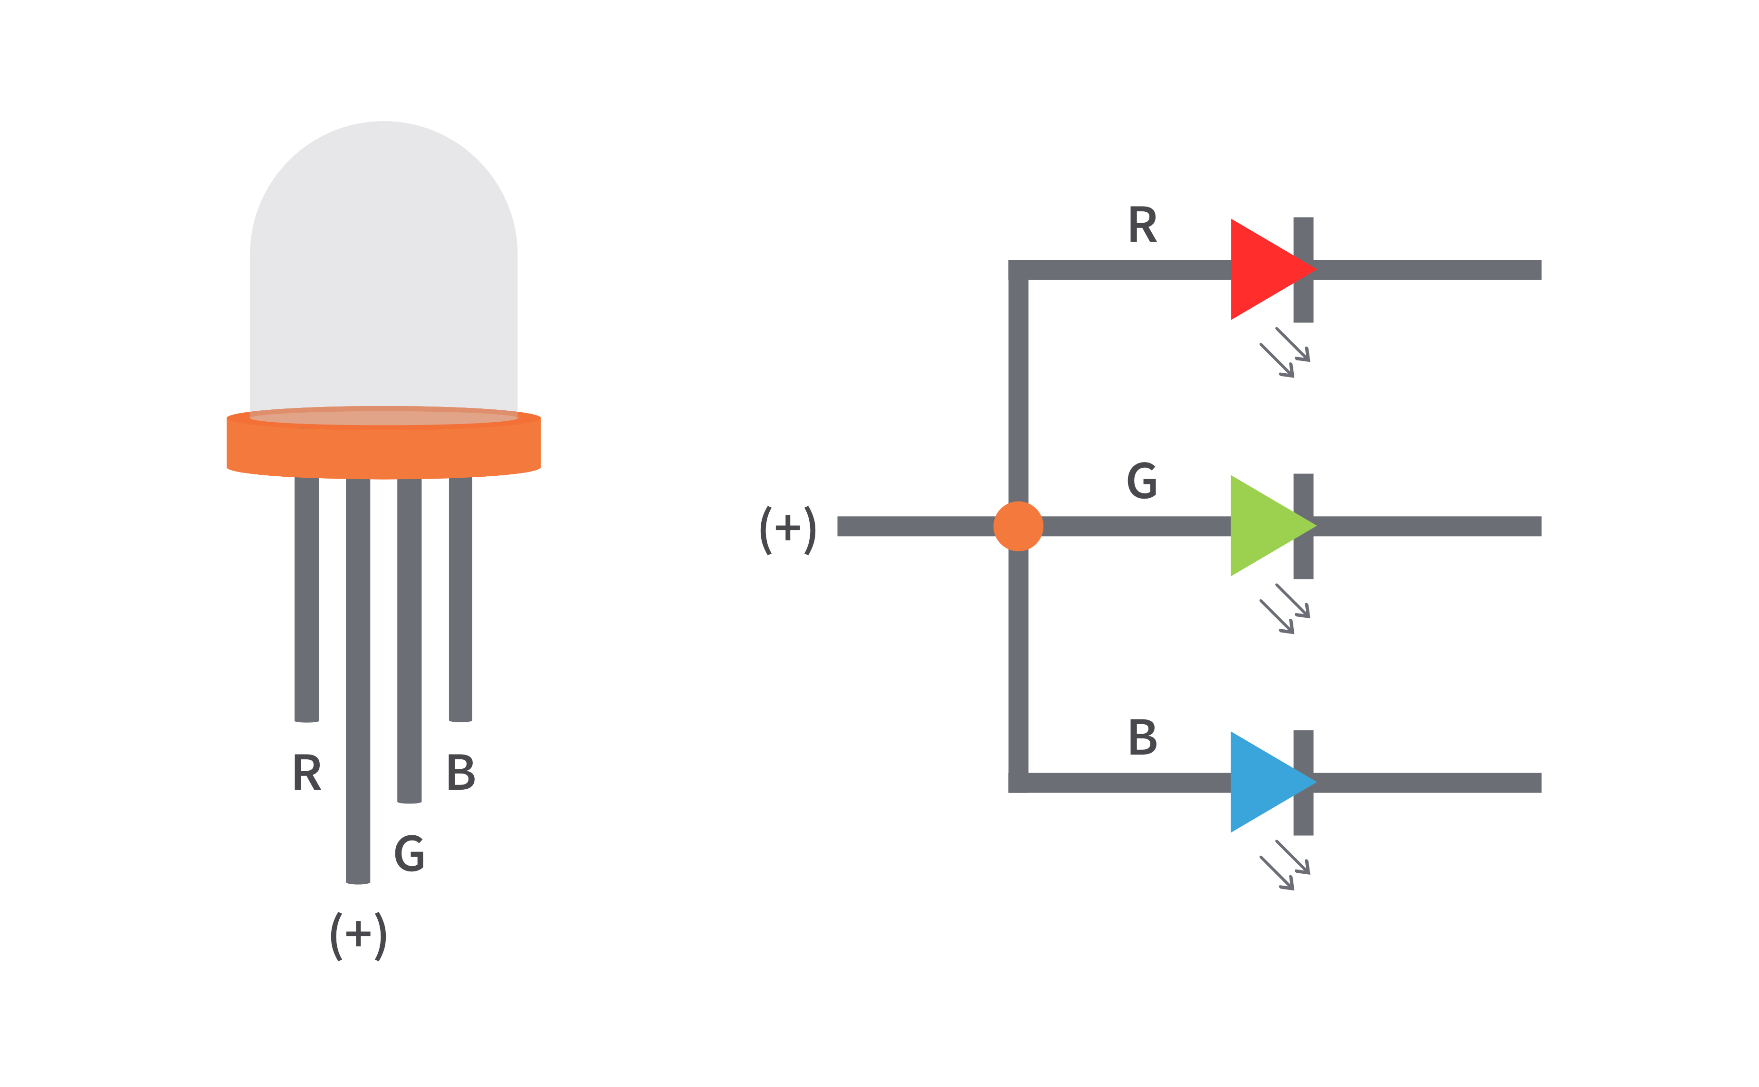
Connection
RGB LEDs are connected to PCA9685 and by controlling 2¹² (4046) intensity levels, 2³⁶ (6.872x10¹⁰) colours are created
0
SCL
I2C bus master
device
PCA9685
ATMega328
15

Slide 12
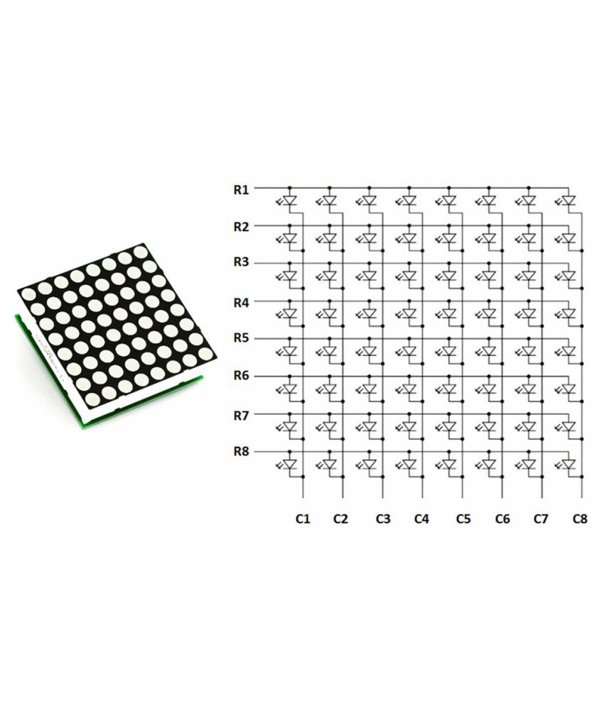
Special efforts
8x8 LED matrix can be controlled from a PCA9685 module
So, 64 LEDs can be connected to a PCA9685
3968 LEDs can be controlled using 62 PCA9685

Slide 13
Block Diagram
Switching
Brightness control
SCL
I2C Slave Device
16 Channel
12 Bit
LED Driver
I2C bus master
SDA
device
8 channel
ATMega328
PCA9685
8 channel

Slide 14
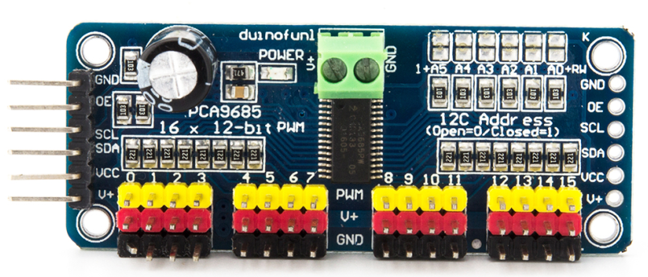
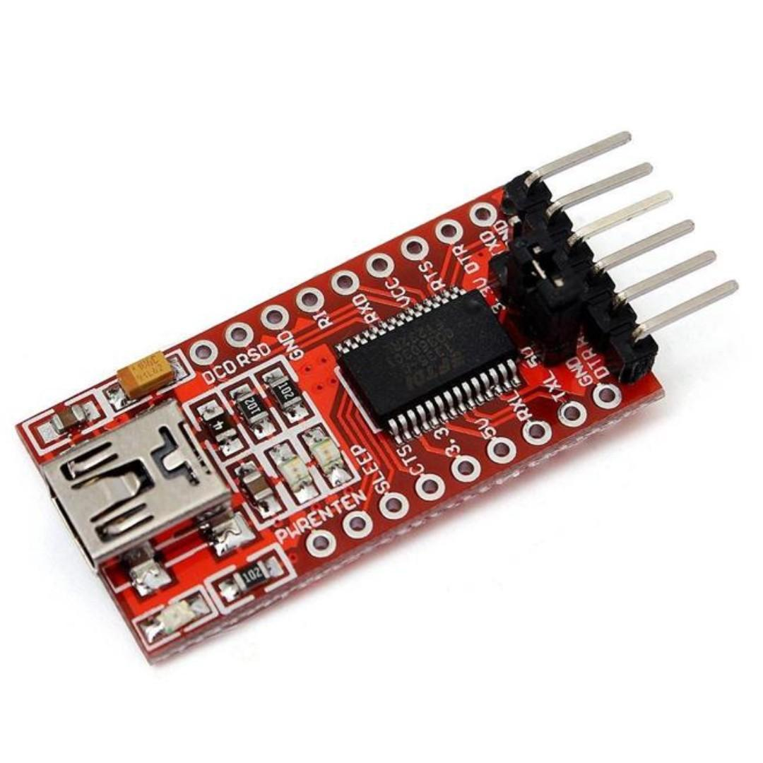
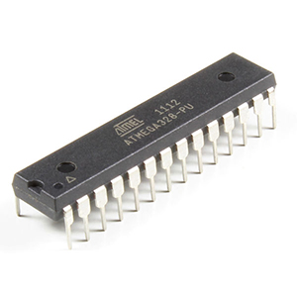
Components
Arduino UNO
ATMega328
16Mhz Crystal
22pFCeramic Capacitors
7805 voltage regulator
FTDI module
PCA9685 Module
RGB LEDs
10uf , 0.1uf capacitors
10k resistors

Slide 15
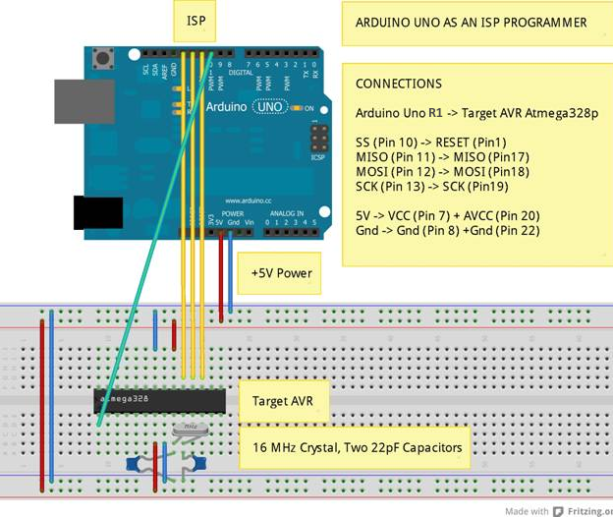
Methodology
Circuit is designed
Boot loader is downloaded into ATmega328

Slide 16
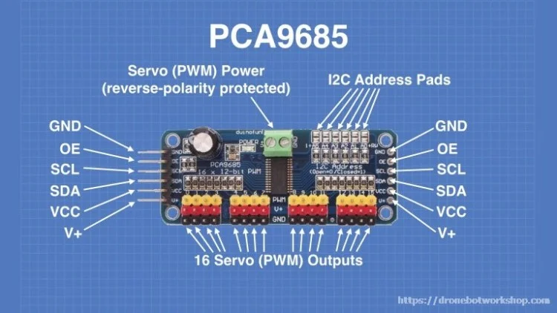
Methodology
PCA9685 Module is interfaced to ATMega328
LEDs are connected to the PCA9685 output via 10K resistors
Using Arduino IDE and FTDI microcontroller is programmed.

Slide 17

Result
I2C LED controller prototype

Slide 18
Problems faced
Downloading Bootloader
Downloading program to ATMEGA328
Writing Program using libraries of PCA9685 and I2C

Slide 19
Conclusion
Hardware configuration of PCA9684 support 16 distinct output connections (channels)
New configuration designed can drive 64 distinct connection from each module

